Slide 1

Heuristic methods and their respective pros and cons in regionalization algorithms

Slide 2
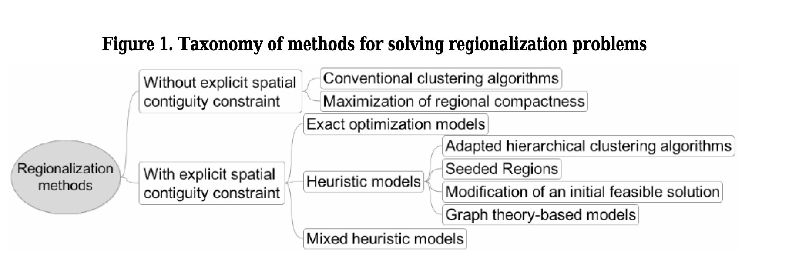

Slide 3
Adapted hierarchical clustering algorithms
The core tenet of this regionalization approach is to use only the adjoining regions that are then combined using traditional hierarchical clustering algorithms.
Before starting the regionalization process, each area is considered to be a separate region.
With every iteration of the algorithm, areas are combined, considering one at a time until the targeted number of regions is reached
Relationships between areas do not have to be geographically-dependent
Neighboring relationships must be provided
Spatial contiguity is guaranteed
Optimal solution is not guaranteed
Cannot be easily adapted to any aggregation criterion

Slide 4
Seeded regions
The main characteristic of these heuristics is that each region is the result of selecting one area (seed area) to which other neighboring areas are assigned. The seeds can be generated one at the time, which implies that the next seed is selected after a region is completed; or in parallel, when all the seeds are selected at once.
The underlying approach behind the seeded region algorithms is to take seeds or regions into account rather than the whole area. And then add other seeds. The second seed should be furthest away from the first one.

Slide 5
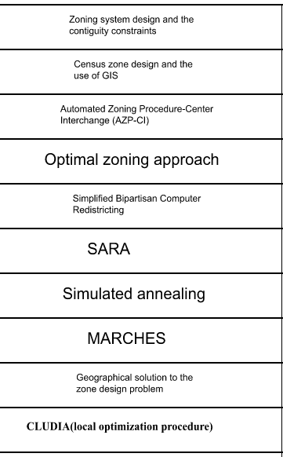
Modification of an initial feasible solution
Each iteration of the methods presented must be possible in terms of the spatial contiguity constraint, starting with a viable initial solution that is then improved repeatedly.
There are various challenges faced in the fields of clustering, scaling and aggregation, identification of the most compact division of a region, redistricting automation, verification of region contiguity, member redistribution, zone design, p-regions, and zoning system design.
There are different algorithms proposed by different people in relation to this which are an improvement to the initial algorithm.

Slide 6
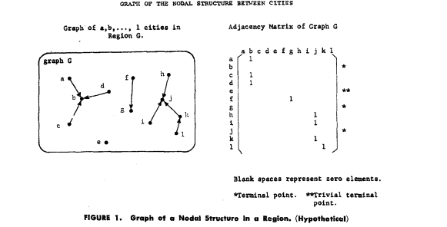
Graph-theory-based models
In this approach, the objective is to achieve two goals. Graph theory-based models are implemented when the clustering has to satisfy certain constraints.
In graph terminology, the objects can be pictured as the vertices of the graph and the edges can correspond to several aspects depending on the objective of clusterization.
Edges might define objects connected by specific transport methods such as rail or air, utilities such as electricity and telephone lines, or simply, the distance between them. Then the district formation problem is reduced to finding connected subgraphs.

Slide 7
Mixed Heuristics models
Break the regionalization problem into subproblems
Combine heuristic and exact optimization models to solve regionalization problems.
Aim of these models is to merge in one model the computational power of heuristic approaches with the mathematical accuracy of exact models.
Use of heuristic concentration (use information from multiple solutions, obtained by any regionalization heuristic)
Use of heuristic distillation (uses information from multiple solutions obtained from any heuristic model)

